Slide 1
STORMWATER RUNOFF
A GROWING SOURCE OF POLLUTION OF OUR STREAMS, RIVERS AND BAY
WHAT IS STORMWATER RUNOFF?
Notes:
3 min

Slide 2
What Is Stormwater Runoff?
https://www.youtube.com/watch?v=kyH02NjyfPA

Slide 3
Sources of Pollution
What’s threatening the Bay?
Nitrogen. Phosphorus. Sediment. These are the major pollutants responsible for the decline of water quality in the Chesapeake Bay and its tributaries.
Nitrogen and phosphorus are nutrients that are essential food in the right quantities, but too much can be lethal to the Bay. Too much nutrients spawn the growth of algae which turns the water green and can be toxic to marine life,
When those algae die, they rob the water of oxygen and create “dead zones” where fish, oysters, clams, and crabs can’t survive.
Sediment is soil that washes into the Bay when it rains. It clouds the water and prevents underwater grasses from growing. These grasses produce oxygen and provide a place for young fish and crabs to develop and thrive.

Slide 4
Sediment run-off clouds waterways

Slide 5
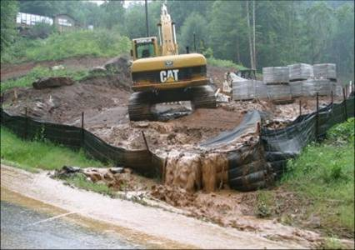
Exposed Soil = Pollution
Enough soil can erode from a typical construction to pollute three miles of downstream waters for a century.

Slide 6
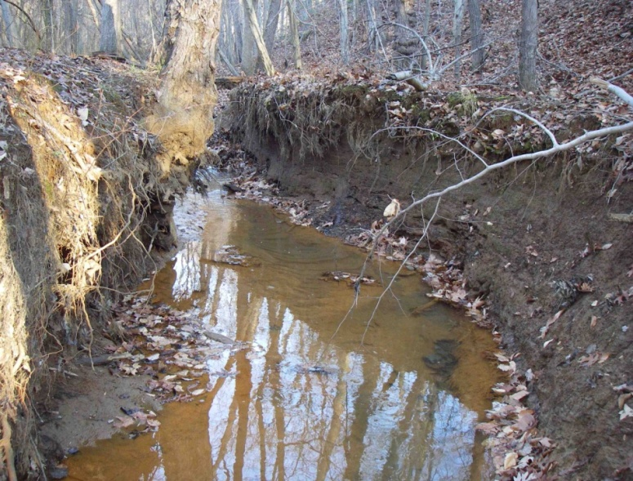
Degraded Streams =
Sediment pollution
Assessed Perennial Stream Miles = 410
Sediment Yield | Miles
High | 134
Moderate | 210
Low | 66
20
17

Slide 7
Sediment in Crofton Park

Slide 17
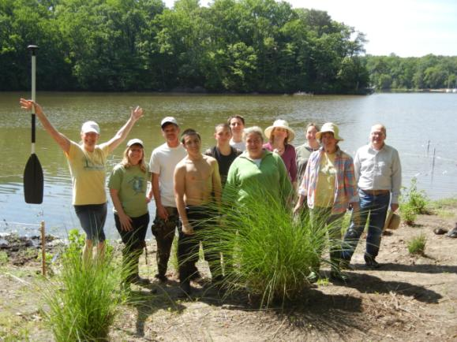
WSA: Supporting Community Leaders to Restore Watersheds
(www.aawsa.org)

Slide 18
Learn More
www.aawsa.org
Web site of Anne Arundel Watershed Stewards Academy
Watershed information
Pollution source information
Pollution mitigation practices
Links to many resources
Master Watershed Steward information

Slide 19
What Is Anne Arundel County Doing to Solve the Stormwater Problem?
Many projects have been completed, such as the Cabin Branch Restoration

Slide 20
Cabin Branch Stream Restoration
https://www.youtube.com/watch?v=0kWKXQSq_Gk

Slide 21
Learn More
www.aarivers.org
Web site of Watershed Protection and Restoration Program (WPRP)
WPRP Information
Restoration sites
Little Patuxent Watershed Study just completed

Slide 22
Things You Can Do
Direct Downspouts To Planted Areas
Install Rain Barrels
Install Rain Gardens
Replace Lawns With Natural Areas
Plant Native Trees and Shrubs
Plant Along Streams
Pick up dog waste
Report construction site pollution (www.ceds.org)

Slide 23
COMMUNITY INVOLVEMENT Saving Steams in the Cedar Run Watershed
http://www.stormwaterpa.org/saving-streams-in-the-cedar-run-watershed

Slide 24
Soak Up the Rain
https://www.youtube.com/watch?v=DybVanTc5sc

Slide 25
It’s Up to Us: Clean or Green
https://www.youtube.com/watch?v=WaIrLFq3DGI

Slide 26
The Goal

